Slide 1



Magnetic Neutron Scattering
Collin Broholm
Institute for Quantum Matter, Johns Hopkins University
Quantum Condensed Matter Division, Oak Ridge National Laboratory
Supported by U.S. DoE
Basic Energy Sciences,
Materials Sciences & Engineering
DE-FG02-08ER46544

Slide 2
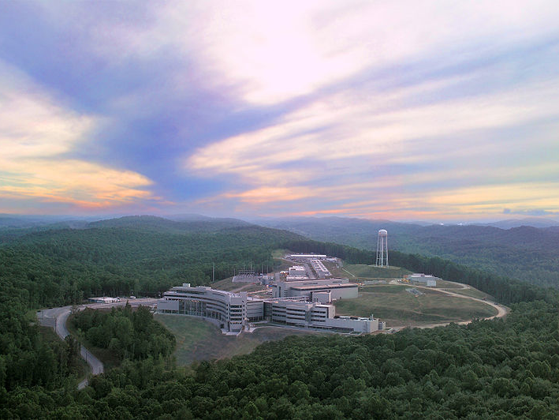
Overview
Neutron spin meets electron spin
Structure : Magnetic diffraction
Excitations: Inelastic magnetic scattering

Slide 3
Magnetic properties of the neutron
The neutron has a dipole moment
μ_{n} is 960 times smaller than the electron moment
A dipole in a magnetic field has potential energy
Correspondingly the field exerts a torque and a force
driving the neutron parallel to high field regions

Slide 4

Magnetic Neutron Optics
The combined nuclear and magnetic potential for neutron
The index of refraction is
Critical angle for total external reflection:
Polarized beam!

Slide 5
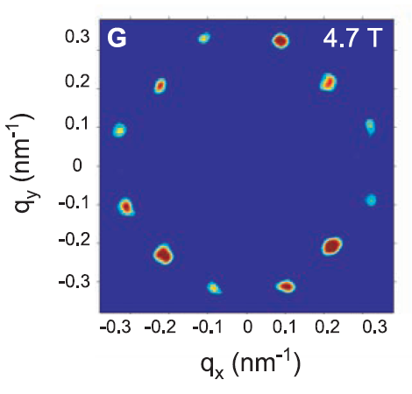
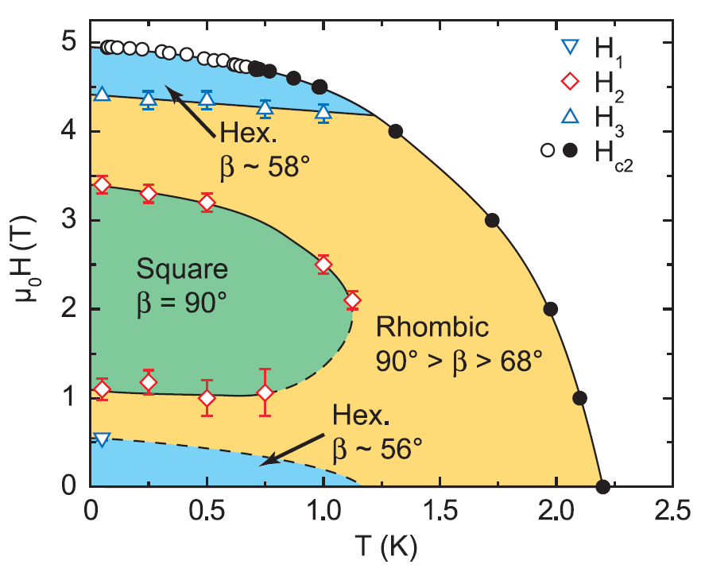
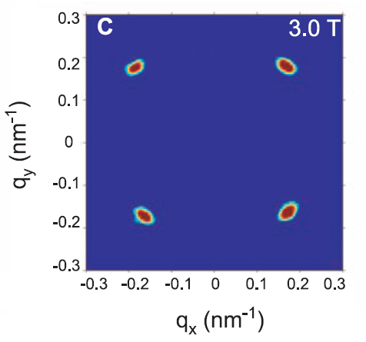
Structure of vortex matter: CeCoIn₅
Bianchi et al., Science (2008)

Slide 6
The transition matrix element
The dipole moment of unfilled shells yield inhomog. B-field
The magnetic neutron senses the field
The transition matrix element in Fermi’s golden rule
Magnetic scattering length ~ nuclear scattering lengths
It is sensitive to atomic dipole moment perp. to

Slide 7
The magnetic scattering cross section
Spin density spread out scattering decreases at high q
The magnetic neutron scattering cross section
For unspecified incident & final neutron spin states

Slide 8
Un-polarized magnetic scattering
Squared form factor
DW factor
Polarization factor
Fourier transform
Spin correlation function

Slide 9

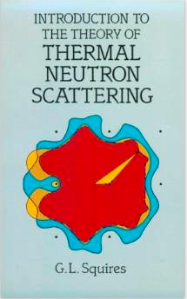
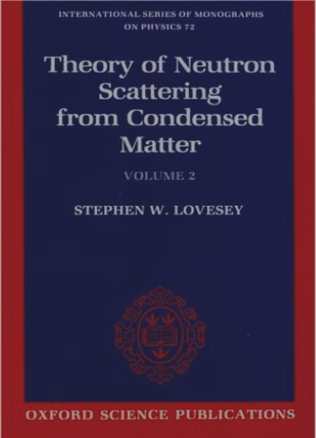


Online lectures accessible at:
http://www.sns.gov/education/qcmp/

Slide 10
Magnetic neutron diffraction
Time independent spin correlations elastic scattering
Periodic magnetic structures Magnetic Bragg peaks
Magnetic primitive unit cell greater than chemical P.U.C.
Magnetic Brillouin zone smaller than chemical B.Z.
The magnetic vector structure factor is

Slide 11
Diffraction from Ferromagnet
Nuclear & magnetic scattering interferes. Effective scatt. length:
The structure factor for reciprocal lattice vector,
Nuclear
Magnetic
Nuclear-magnetic
The last term vanishes for un-polarized neutrons ( average).
A welcome consequence is that the diffracted beam is polarized!

Slide 12
Simple cubic antiferromagnet
Real space
‘
No magnetic diffraction for
Reciprocal Space

Slide 13
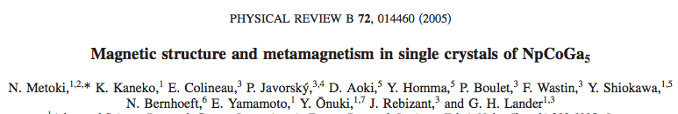
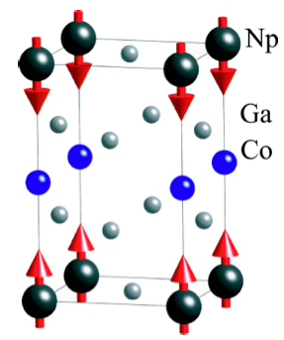
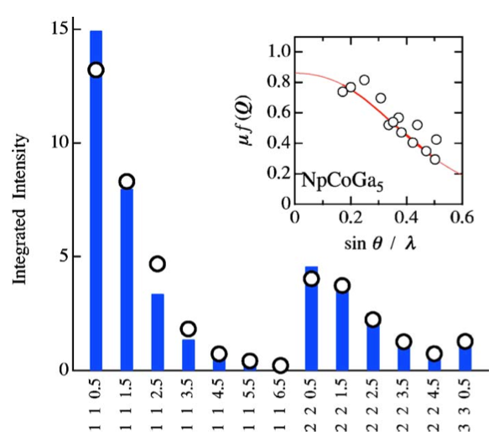
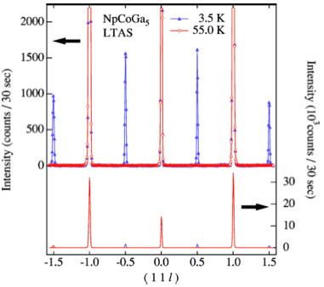

Slide 14
Not so simple Heli-magnet : MnO₂
c
b
a
and
characterize structure
Insert into diffraction cross section to obtain

Slide 15
Magneto-electric transition in TbMnO₃
Kimura et al (2003)
Incommensurability indicates competing interactions
Ferro-electric distortion from competing interactions?
Notes:
Recent interest in the area of magneto-electricity grew out of beautiful experiments by Kimura et al from the Tokura group on TbMnO3. This is a distorted perovskite material in which orbital ordering leads to competing interactions that produce a magnetic state with a modulation that varies with temperature. Though it is not what we might conventionally consider a frustrated magnet, the incommensurate structure actually does signal competing interactions that are being balanced for a compromise that minimizes the free energy rather than a state that corresponds to fluctuations about a unique lowest energy state of the spin system. It is under these circumstances that lattice energy and magnetoelastic effects can come into play. And indeed at T=28 K there is a sharp peak in the dielectric constant and evidence for the development of spontaneous surface charge density whence a ferro-electric state. The magnetic phase diagram as a function of temperature and field is shown to the right. Focusing on the zero field states in succession upon cooling there is a PM followed by three different modulated states. The lowest temperature state corresonds to the development of Tb spin order. Lets set that aside for now. The intermediate state is ferro-electric. The initial suggestion was that this was a commensurate magnetic state and a socalled lock in phase transition that produced ferro-electricity.

Slide 16
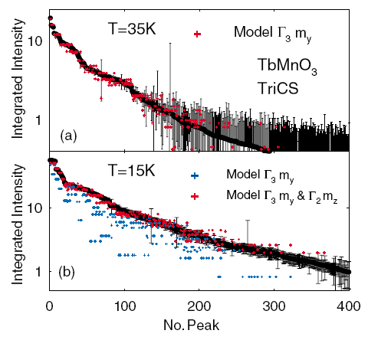
Longitudinal to transverse modulation
Kenzelmann et al (2005).
Notes:
Informed by this work we examined two aspects of this system more closely through magnetic neutron diffraction.
First I would like you to focus on the bottom left graph which shows the wave vector of the modulated magnetic structure as a function of temperature. After an initial rapid evolution there is a transition to a state with much weaker variation of wave vector with T. Contrasting these the lower T state resembles a state with a specific wave vector. However, q continues to change with T as is clearly evident from he inset. So we can say definitively that this is NOT a lockin transition. The top graph shows the peak intensity versus T which indicates an anomaly at the temperature corresponding to the transition.
Here is what we found to be happening at the transition. At high T there is a longitudinal modulation of the magnetization density, which then switches to a transverse modulation at 28 K, the same temperature at which ferroelectricity develops.
Lets examine the structure in greater detail because this will be important for all the remainder of the talk. First note that because angular momentum is an axial vector inversion replaces a spin at –r by the same spin at r. The longitudinal structure above clearly posseses a point of inversion right in the middle of the image and I have indicated that by a circle. However, the transverse modulated structure shown below does not have a point of inversion. The magnetic structure breaks inversion symmetry. We shall see that this is a common feature of these magneto-electric structures. In fact all systems that we have looked at in which the magnetic state breaks inversion symmetry and has a polar axis are also ferroelectric in that phase.
In passing I should mention that to carry out a full solution of the magnetic structure for a complicated system like this requires hundreds of magnetic Bragg peaks. For this work we used a four circle diffractometer with a domed displex at the PSI in Switzerland. Within years the premier facility for this type of work will be at the SNS in the form of TOF SCD instrument.

Slide 17
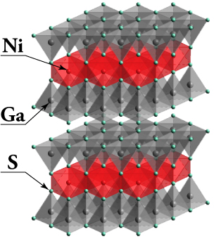
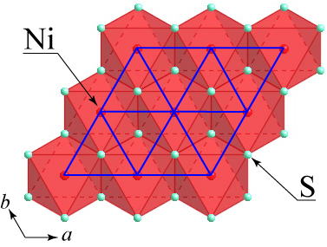
NiGa₂S₄ : Spin-1 Triangular Lattice AFM
Nakatsuji et al. Science (2005)
J₁: FM
J₃ : AFM
Dominant 3rd neighbor interactions
Exact triangular lattice
Weak easy plane anisotropy
Unusually weak interlayer coupling
Notes:
NIGAS is a model system for the spin-1 triangular lattice AFM. While there is good reason to look at spin-1/2 systems for their extreme quantum nature and the possibility of an RVB state, spin-1 is the only transition metal ion that really fits on a triangular lattice and which can be expected to exhibit pure spin physics.
A very important aspect of NIGAS is the extreme 2 dimensionality. Each layer is part of an electrically neutral slab that is separated from the nearest neighboring layers by a van der Waals gap. This not only means that inter-layer interactions are weak but we can also expect unusually strong 2D librations.
Each layer consists of octrahedrally sulphur coordinated Ni. Neighboring coordinating octahedra are edge sharing with lattice parameter 3.6 AA and this give rise to Ni-S-Ni bond angles that are very close to 90 degrees. As a result we can expect the nearest neighbor interaction to be weak and FM. There is also the potential for a bi-quadratic (quadrupole) interaction as a result of magneto-elastic effects due to librations of that bond angle.
Perhaps surprisingly at first, it is actually the third nearest neighbor interaction that is largest and antiferromagnetic in this compound because at xxx degrees the bond angles are conducive to AFM superexchange even if two sulphur atoms are involved.
So we are in for some surprises when we look at magnetism in this family of materials.

Slide 18
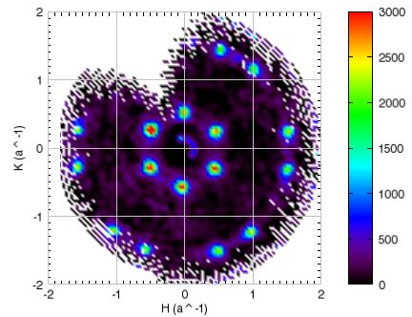
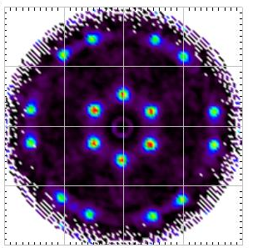
NiGa₂S₄: Elastic Magnetic Scattering
Notes:
And here finally then is the map of elastic scattering from NIGAS. Now these are completely raw T-difference data as they come off the machine. You see a beautiful set of peaks corresponding exactly to that incommensurate structure that was inferred from the powder data.
You will note the peaks are at the locations advocated and that in comparison to the TeVO4 long range order data are considerably broadened and this indicates a short correlation length of just 25 AA or 7 lattice spacings.
Now for a better look at the data we have a couple of operations that we can carry out. Unpolarized scattering should be unaffected by rotating the sample 180 degrees about any axis to we superimpose the data on a 180 degree rotated version for even covereage in momentum space.
Further we’d assume 6 fold symmetry is retained macroscopically so that we can project all the data into a 60 degree wedge for best possible statistics. Now you can even see potentially diffuse scattering showing up between these features.

Slide 19
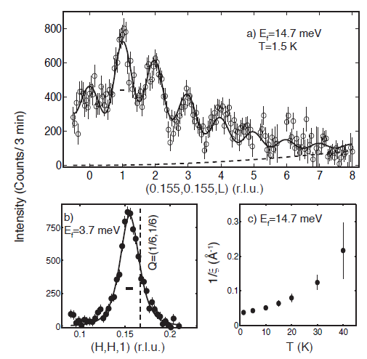
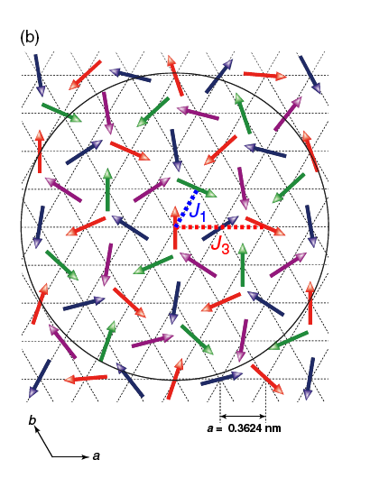
Short range magnetic ordering
C. Stock et al. PRL (2010)
Notes:
This slide from the recent PRL by stock summarized what we learn about the magnetic LT structure of NIGAS from elastic magnetic neutron diffraction: short correlation length along c, incomensurate correlations in the basal plane and a correlation length that has a non-singular development as a function of temperature.
The image shows the inferred short range ordered spin structure. Since there is just one spin per 2D unit cell the wave vector and the spin plane are the only degrees of freedom in the refinement and the data is best accounted for by in-plane spins.
Had there only been J3 interactions then the spin system would break up into four sublattices each with 120 degree order and these are colored red, green, blue and pink. The effect of J1 is to slightly shift the wave vector towards the FM q=0 point were all spins are parallel. However, it does not obviously get very far because it is in competition with the stronger antiferroamgentic exchange constant.
What’s

Slide 20
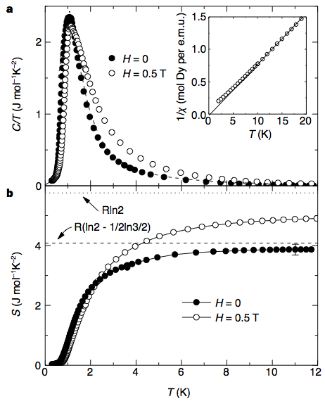

Ising FM : Spin-Ice
A. P. Ramirez et al.
Nature (1999)
Notes:
Ising FM Interactions. AFM case is not so interesting as it produces long range ordering.
The definition of the Ising sipn variable and the effective change in sign to a AFM model of interacting Ising variables. Here a competition between Anisotropy and interactions. Interactions would like all spins parallel but this is not possible.
The manifold is entropic and can determine that entropy

Slide 21
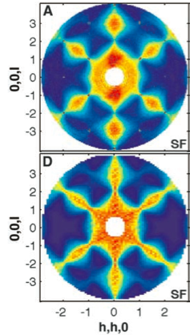
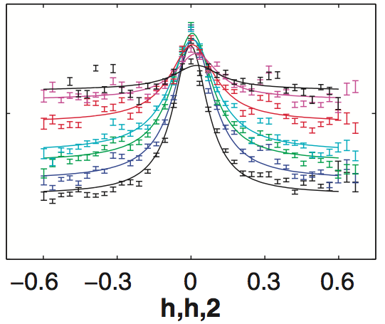
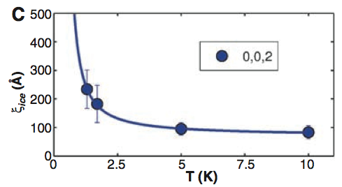
Pinch points and monopoles in spin ice
Fennell et al. Science (2009)
Experiment
Theory
Notes:
And this was utilized in measurements by Fenell et al on Dy2Ti2O7 what show the T-dependent length scale associated with defect tetrahedra. .
Now I glossed over

Slide 22
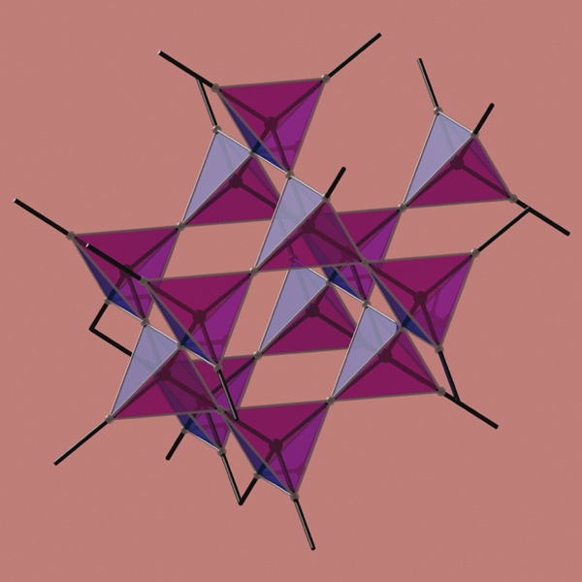
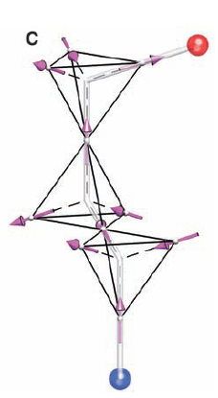
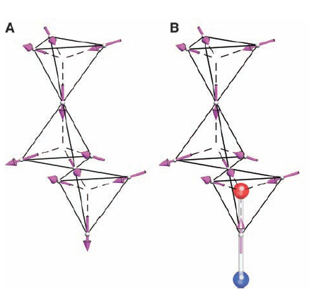
Emergent Magnetricity
A manifold of ice-rule states
From dipoles to monopoles
Ising spin
Ice rules: two in two out
Castelnovo, Bramwell, Moessner et al.
Notes:
As the defects move apart they also become independent physical entities that have monopolar character. And this is now a mature field of inquiry where the existence of monopolar degrees of freedom is well established.

Slide 23
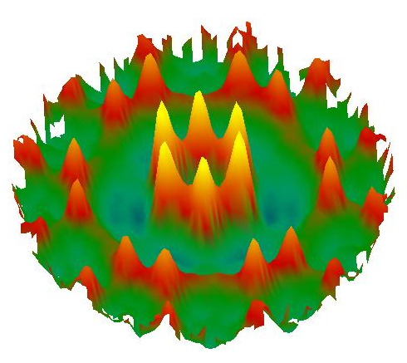
Summary: Diffraction
The neutron has a small dipole moment causing scattering from electrons
Magnetic scattering is similar in magnitude to nuclear scattering
Elastic magnetic scattering probes static magnetic structure
Spin direction gleaned from polarization factor (see spin perpendicular to Q)
Periodic structure determined through Bragg intensities
Generally probe magnetic structure on 1-10⁴ Å scale:
  flux line lattice
  short range order
− powder, single crystals, thin films

Slide 24
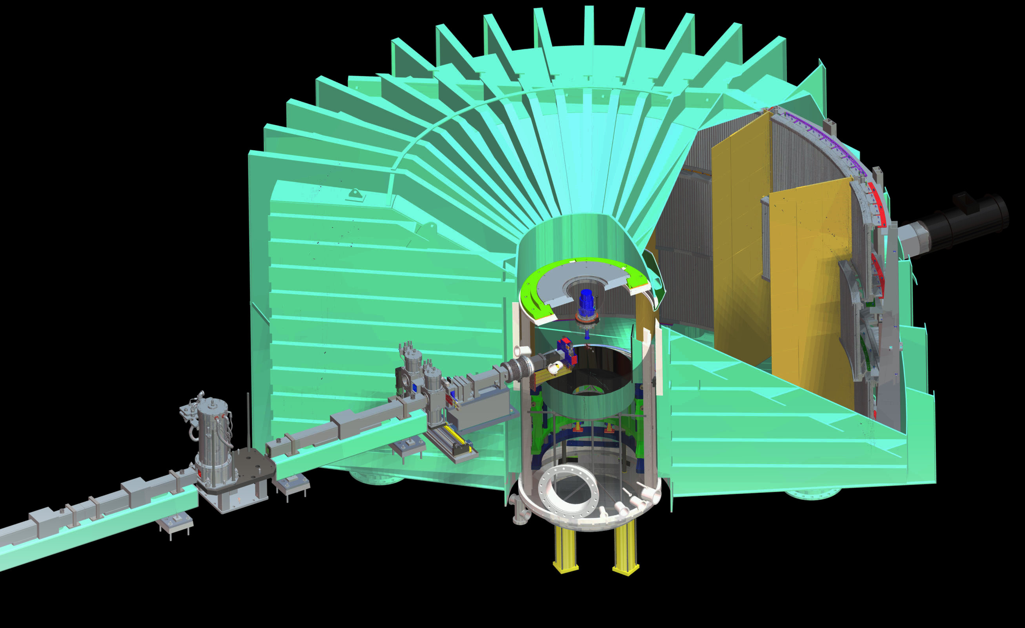
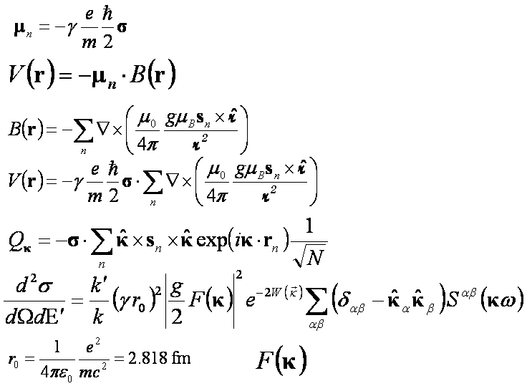
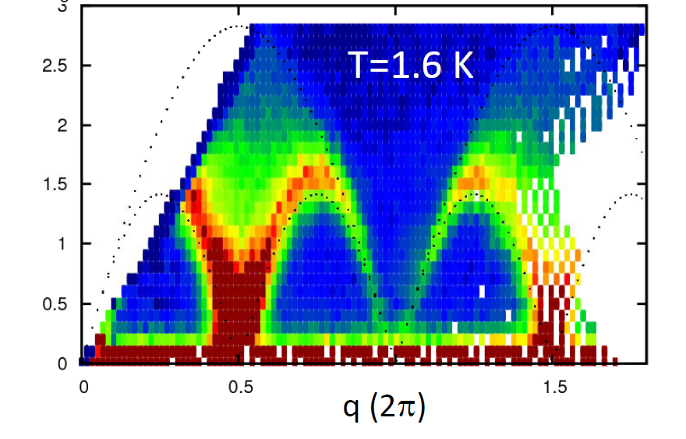
Inelastic Magnetic Neutron Scattering
Features of the cross section
The dynamic correlation function
Fluctuation Dissipation theorem
Sum-rules
Examples
Summary

Slide 25
Understanding Inelastic Magnetic Scattering:
Isolate the “interesting part” of the cross section
The dynamic correlation function (“scattering law”) :
In thermodynamic equilibrium (detailed balance):

Slide 26
Useful exact sum-rules:
Total moment sum-rule (general result from Fourier analysis)
Correlations in space & time rearrange intensity in space leaving the total scattering scattering unaffected
Definition of the equal time correlation function:
The wave vector dependence of the energy-integrated intensity probe a snap-shot of the fluctuating spin configuration

Slide 27

Fluctuation Dissipation Theorem
Define the following t-dependent “response” function:
The generalized susceptibility can be expressed as:
The “scattering law” can be expressed as:
From which, the “fluctuation-dissipation” theorem:

Slide 28
First Moment Sum-rule
Fourier transform of expression for scattering law:
Time derivative of left side evaluated for t=0:
Time derivative of right side evaluated at t=0:
Equating these leads to the first moment sum-rule:

Slide 29
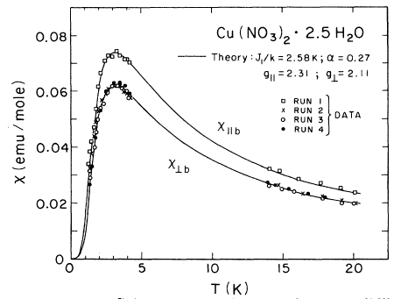
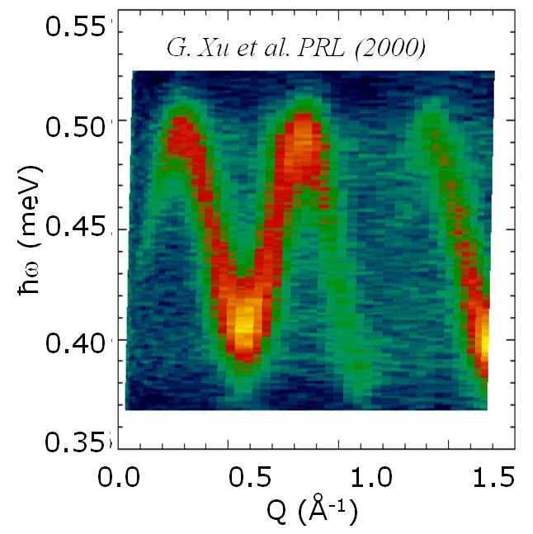
Weakly Interacting spin-1/2 pairs in Cu-nitrate

Slide 30
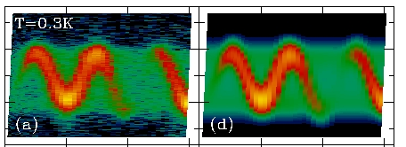

Sum rules and the single mode approximation
When a coherent mode dominates the spectrum:
Sum-rules link and :
Exp. data
Single mode model
0.5
0.4
0 2 4 0 2 4 6

Slide 31
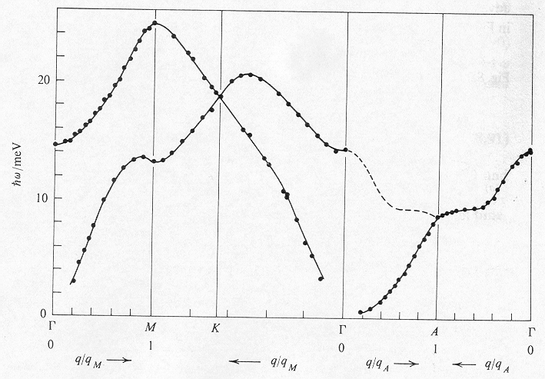
Spin waves in a ferromagnet
Magnon creation
Magnon destruction
Gadolinium
Dispersion relation
Occupation number

Slide 32
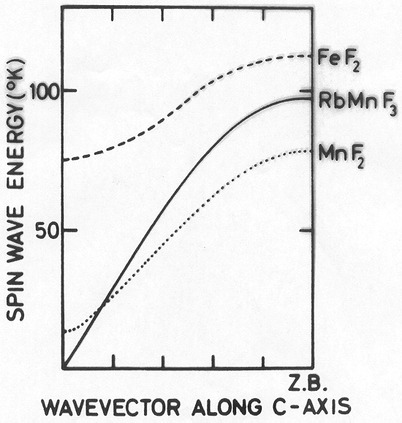
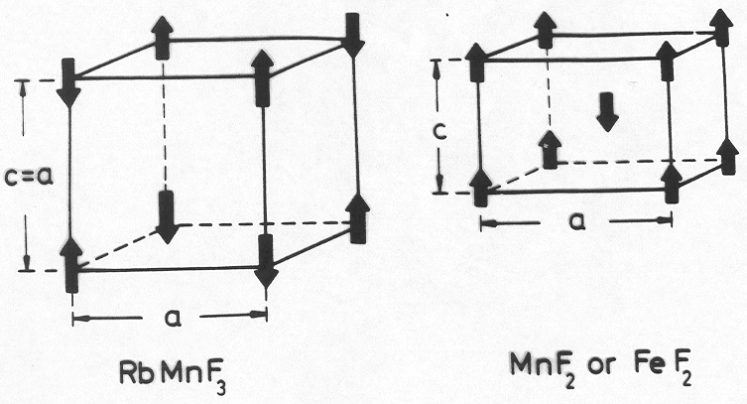
Spin waves in an antiferromagnet
Dispersion relation

Slide 33
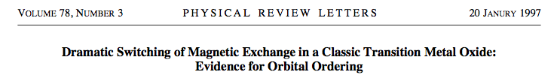
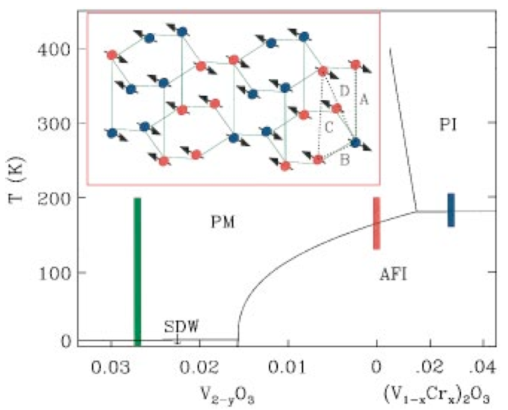
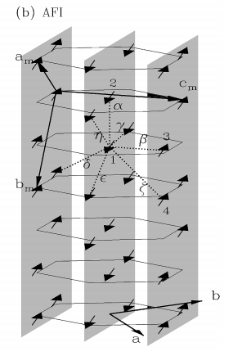
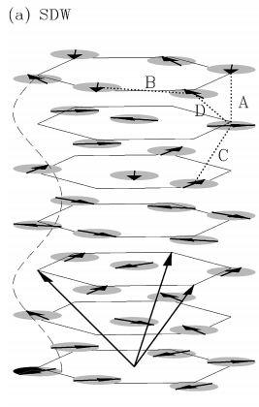
Notes:
So here is the phase diagram which shows the several strongly correlated phases of V2O3 as a function of doping. When we dope a small amount of chromium into V2O3, it goes through a Mott metal to insulator transition. We specifically looked at a sample with 4% Chromium doping in both the antiferromagnetic insulator phase and the paramagnetic insulator phase above the transition temperature of around 185 K.

Slide 34
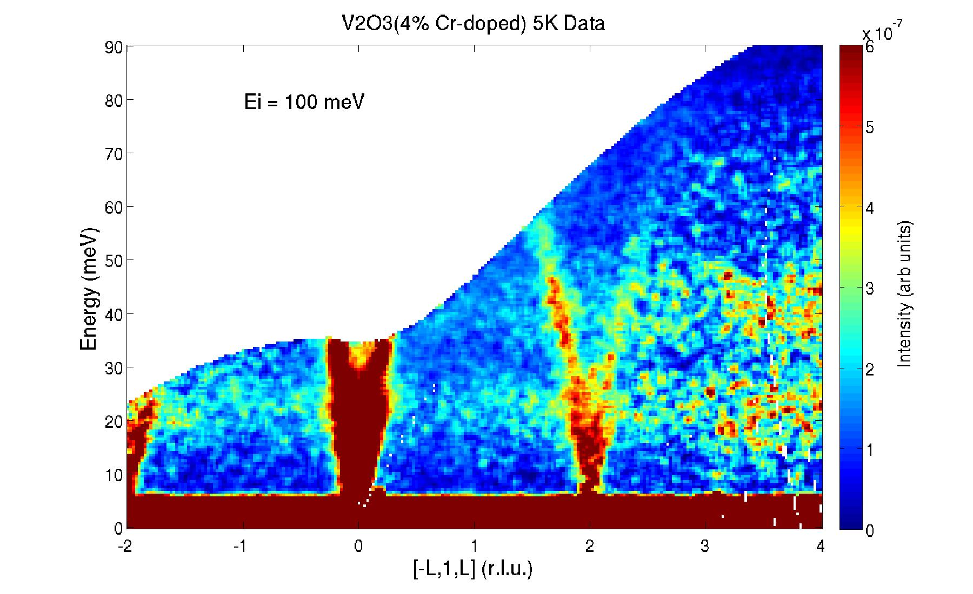
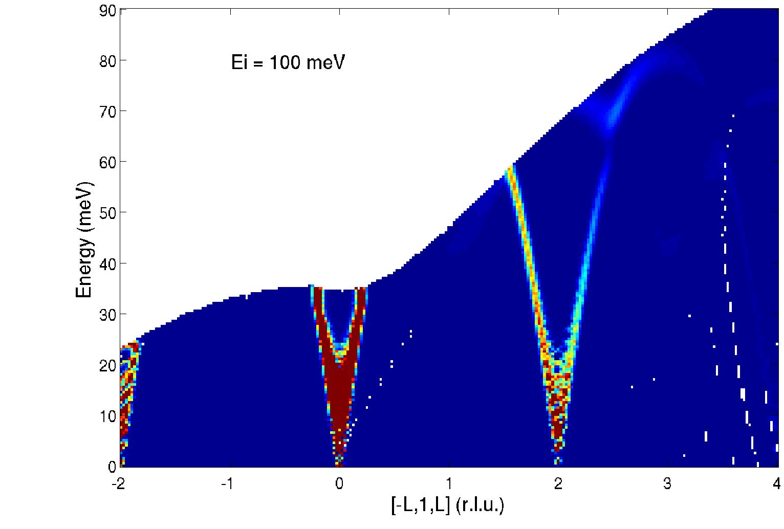
Spin-Waves in AFI phase of V₂O₃
Notes:
We can now look at what happens to the dispersion as we cross the transition temperature.

Slide 35
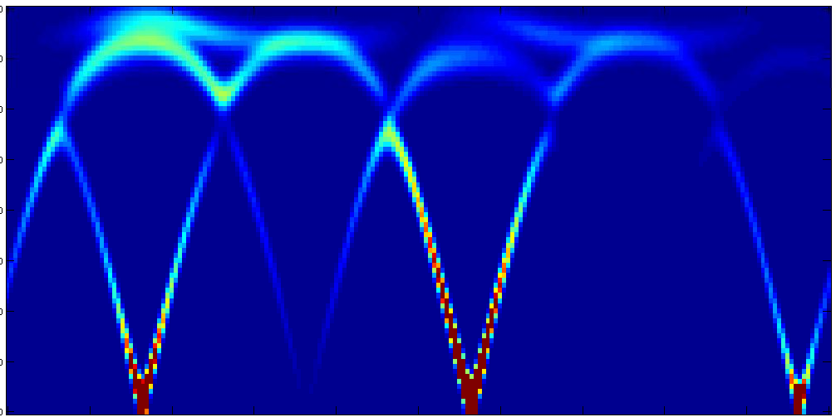
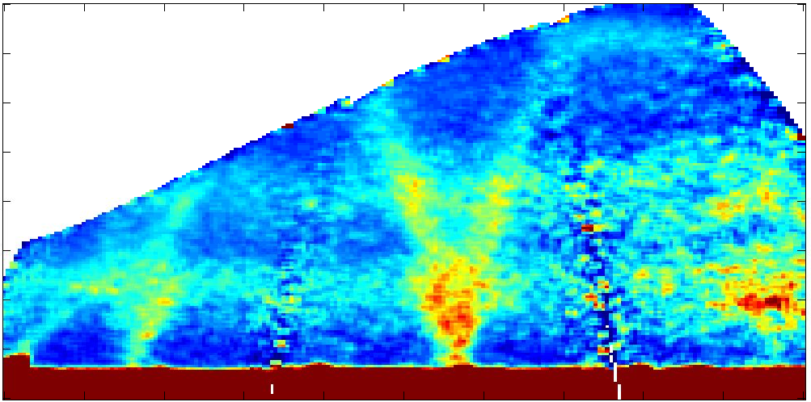
Spin-Waves in AFI phase of V₂O₃
70
35
0
E (meV)
70
35
0
0 1 2 3 4
[-2 1 L]
Notes:
And finally we can see the top of the dispersion along the monoclinic c direction. We can see here in the data this flat feature just above 70 meV.

Slide 36

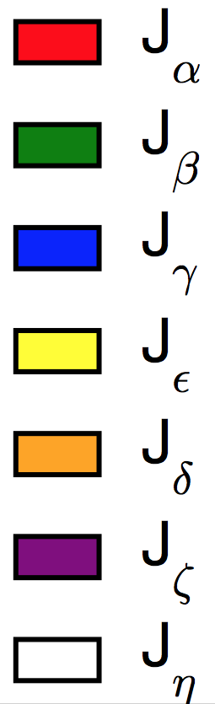
Exchange in strongly correlated V₂O₃
= -4 meV
=17.3 meV
= 0 meV
= 0 meV
= 1.7 meV (constrained)
= 7 meV
=-1.7 meV
Jon Leiner
LDA+U methods will be benchmarked
against the experimental results
Roser Valenti et al
Notes:
So now that we are sure we have the structure of the spin waves correct lets see if we can get the correct exchange constants by fitting the dispersions along each direction that we can see. I can figure out from the data what the slope of the dispersion is and where the top of the dispersion is along the hexagonal c-axis, the direction perpendicular to [0 k 0], and finally the individual monoclinic a and c directions. (point out the values where the curves should turn over).

Slide 37
Probing matter through scattering
Intensity
Single Particle
Process
ћω
Intensity
Multi Particle
Process
ћω
Notes:
For an interpretation of the data we shall start with the assumption that the spin-1/2 chain does support some sort of quasi-particle. However, clearly the data show that the underlying quasi-particle cannot be directly created and anihilated as a magnon or phonon in the scattering process.
The observed bounded continuum scattering instead indicates a two particle scattering process. There we control through the wave vector transfer in scattering the overall momentum delivered to a pair of quasi-particles but not the relative momentum. As a result there is a bounded continuum of scattering.

Slide 38
Disintegration of a spin flip in 1D
Spinon
Spinon
Notes:
For a qualitative sense of what these quasi-particles might be consider this image. The neutron scattering process fundamentally is a spin flip process in which a quantum of angular momentum is delivered to the sample as the neutron undergoes a spin flip. The top line thus shows an antiferromagnetic spin chain in which one spin has been flipped. Under the action of the spin hamiltonian, this spin flip however does not remain as a single wave packet but instead separates into two entities that can be associated with quantum domain walls also called spinons.
Had the domain walls formed a bound state we should see well defined sharp modes of excitation corresponding to the excitation of these bound states. Observing a continuum indicates that the spinon quasi-particles act as free particles as they move through the fluctuating ground state of the spin-1/2 chain.

Slide 39
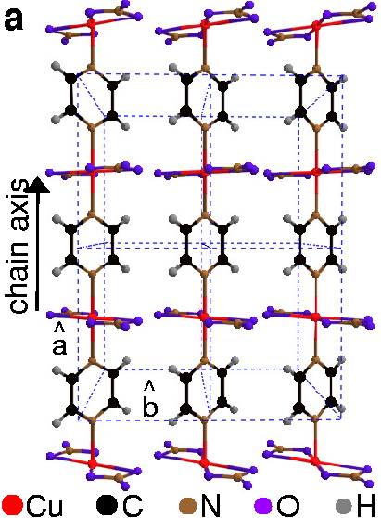
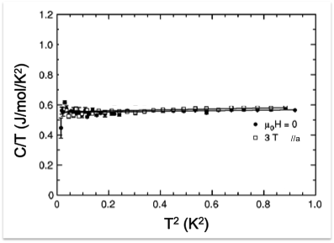
Quantum critical spin-1/2 chain
Cu(C₄H₄N₂)(NO₃)₂
Hammar et al. (1999)
Notes:
To find a spin-1/2 chain we needed the help of organic chemists from Clark University who discovered this compund that beautifully forms one dimensional chains of spin-1/2 with just one copper per unit cell as prescribed.
The specific heat already tells us that something interesting is going on in that we see a linear sommerfeld constant normally associated with a metal in a material that is strictly an insulator.
The linear specific heat indicates that the spins have actually formed a fermi surface that mimics the behaior of a metal. We can further magnetize the system much as in a pauli paramagnet and because the energy scales are low we can achieve substantial magnetization, even fully magnetize it.

Slide 40
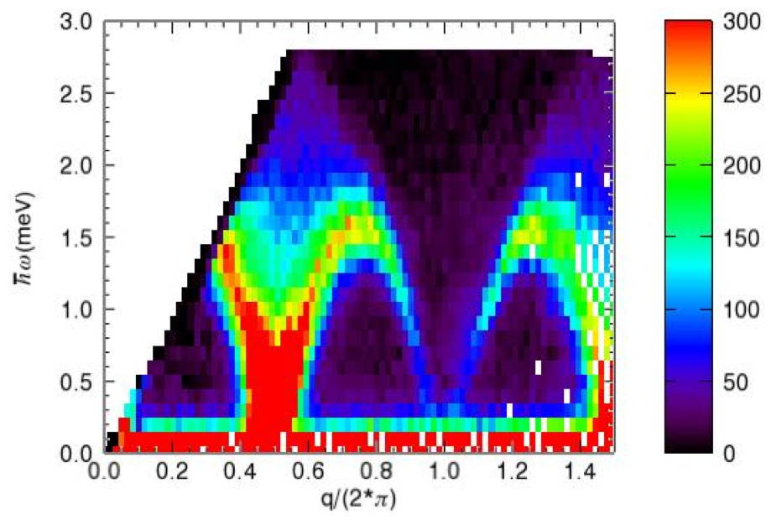
Copper Pyrazine dinitrate
Notes:
With the MACS instrument we can now completely map out the excitation spectrum and directly observe the bounded continuum that is associated with the excitation of a spin flip that has fractionalized into two separate spin-1/2 particles.

Slide 41
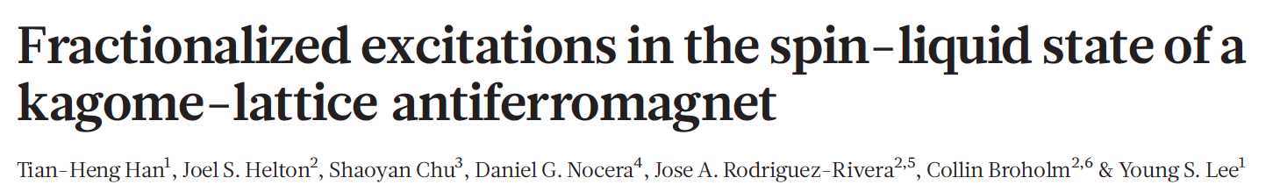
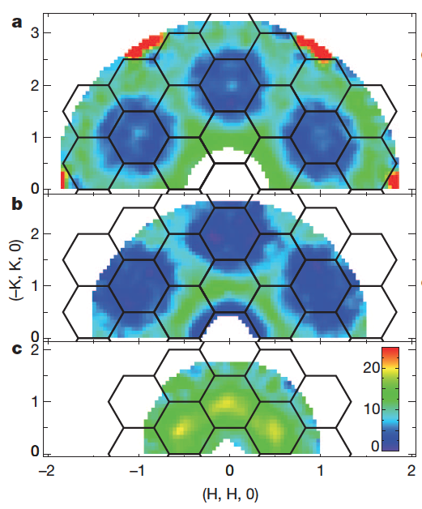
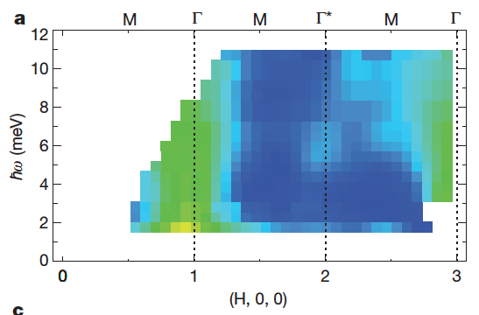
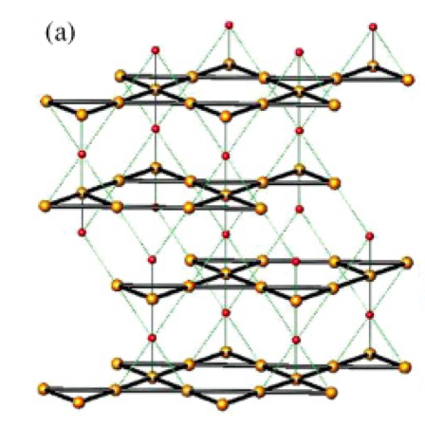


Slide 42



Spinons on kagome
S = ½ kagome AFM has a finite concentration of spinons in its ground state.
Spinons are solitons with spin S = ½ and fermionic statistics.
Spinons cannot be created/anihilated individually
This is manifest in the replacement of a coherent mode by a continuum
Z.-H. Hao and O. Tchernyshyov, PRL 103, 187203 (2009).
Y. Wan and O. Tchernysnyov, ArXiv 1301.5008v1 (2013)
Z. H. Hao and O. Tchernysnyov, ArXiv arXiv:1301.3261 (2013)
Notes:
Here we had an excellent introduction to the theory and materials by Mendels. But let me add the insights of my colleague Oleg Tchernyshyov has been thinking about the ground state and magnetic excitations of the quantum kagome AFM.
Just like the pyrochlore systems, the kagome AFM has a local constraint that is insufficient to induce long range order.
The energy of the kagome AFM is minimized when each triangle carries the least possible magnetization. For spin-1/2 the lowest spin we can have in a combination of three is spin-1/2 and it corresponds if you will to having formed a singlet on the spin triangle leaving one spin-1/2 degree of freedom out. Thus If we can find a state with one singlet on each that should produce a lowest energy spin state. However, there are 6 spins per 4 triangles from which only three singlets can be formed. Thus 1 in 4 triangles has no singlets associated with it and Oleg et al were able to show that it represents a bound pair of spinons.
The physics of the spin-1/2 kagome lattice thus revolves around the properties not of spins on the lattice but of defect triangles. If these are localized and static we have a valence bond solid state with a gap in the excitation spectrum. However, the more interesting case of substantially mobile defect triangles seems to be the case for the kagome lattice.
Here Oleg has shown how these spin-1/2 defect triangles can propagate through the lattice an represent as in the spin-1/2 chain an effective quasi-particle. Interestingly neutrons would not be able to create these individually again because of their spin-1/2 nature. For a better sense of whethere such spinons might account for the data Oleg et al calculated the inelastic scattering cross section in low energy length limit.

Slide 43


1
0
-1
[H 0 ½H]
-4 -3 -2 -1 0 1 2
[0 K 0]
Notes:
So now we can take a quick look at what happens when we raise the temperature of the sample so that it goes into the paramagnetic insulator phase. We see that sharp spin wave intensity suddenly snaps into a much broader distribution of intensity, indicating that the magnetic excitations have become very short range. We also see that the centers of highest intensity shift away to incommensurate positions in between the spin wave peaks.

Slide 44

Evidence for orbital fluctuations
Notes:
We can now look at what happens to the dispersion as we cross the transition temperature.

Slide 45
Is exchange constant ?
Jij is controlled by higher energy physics
that we like to consider irrelevant at low energies
  atomic spacing
  Orbital overlap
  Orbital occupancy
  localized or itinerant electronic states
These degrees of freedom can become relevant
if H produces “degenerate” state
The result can be intricate interplay between
spin charge and lattice sectors

Slide 46



Can critical magnetism induce superconductivity?
Z. Mao et al. (2009)
Hsu F et al. PNAS 2008;105:14262-14264
Notes:
The iron superconductors broke just after we submitted our proposal. However, it was immediately clear that IQM expertise was well suited to address this area. In this case we were delighted to collaborate with Zhiqiang Mao of Tulane University for

Slide 47


From Critical Fluctuations to Resonance
Transverse Slice Along Q_{x}+Q_{y}=1
T=1.5 K
T=25 K
Thampy et al. unpublished
Notes:
Spectral weight is pushed into the famous resonance peak much as in high Tc and in the 115 superconductor.
The data also bear an eary resemblance to observations in a frustrated system that we touched on earlier. ZnCr2O4 is as mentioned a spin Peierls system in that the energy of the spin system is reduced through a lattice distortion that by breaking the symmetries that preclude it allows long range magnetic ordering.

Slide 48



Effects of Superconductivity on magnetism

Slide 49

Spatially resolved magnetic condensation energy
Magnetic “Potential” Energy:
Increased Kinetic Energy
Net condensation energy [C(T)]

Slide 50


V
V₂O₃
Bao et al.
Notes:
So here is the phase diagram which shows the several strongly correlated phases of V2O3 as a function of doping. When we dope a small amount of chromium into V2O3, it goes through a Mott metal to insulator transition. We specifically looked at a sample with 4% Chromium doping in both the antiferromagnetic insulator phase and the paramagnetic insulator phase above the transition temperature of around 185 K.

Slide 51


Spin Fluctuations & Neutrons Scattering
V_{2-y}O₃ Bao et al. PRL (1993)
Notes:
To do so we use the fluctuation dissipation theorem which relates the correlation function to the dissipative part of the generalized spin susceptibility
The spin susceptibility in turn relates to the band structure through the lindhard expression here in a simplified form. There is a summation over all wave vectors so we are not as ARPES going to be directly sensitive to the band structure. But scattering will be enhanced at wave vectors that connect occupied and unoccupied states with energy differences that match neutron energy transfer
What does all this look like? Weill in the case of the famous strongly correlated d-electron system V2O3 there are peaks in the response function at incommensurate wave vectors that reflect nesting conditions upon the renormalized fermi surface. These peaks broaden with energy as phase space opens up and the underlying summation that is involved comes to light.

Slide 52







Slide 53



Field Driven QCP in YbRh₂Si₂
Rh
Gegenwart et al PRL (2002)
Si
Yb
11 ×
Notes:
Next I would like to discuss what might be called a field driven exciton in the famous near quantujm critical material YRS.
This is an extremely anisotropic crystal field dominated system but we are not going to see singlets in the PM state because it is a Kramers ion. It has a delicate low field state that can be driven to FM polarized state through the application of a small magnetic field.
A longitudinal field driven quantum critical point is unusual and it begs the question as to what is the nature of the underlying ordered state. We don’t have the direct answer to that but we have a strong indication from inelastic scattering data.

Slide 54


Incommensurate correlations
Notes:
We find the system is close to an incommensurate spin density like instability in the presence of ridges of scattering much like what I initially showed for V2O3. These two peaks are not counter propagating spin waves because there is no magneic order from which to form the spin waves. Instead the two wave vectors at which the spin susceptibility of the material is enhanced.
So we infer the system has an incommensurate ordered. An applied field intensity shifts to q=0 and higher energies as might be expected since the ground state becomes magnetized.
The progression of the effect to even higher fields produces a very unusual phenomenon that I wanted to share with you. A complete rearrangemen from a continuum of scattering to a resonant mode controlled by the aplication of field.

Slide 55



Field Induced Resonance
C. Stock et. al., PRL (2012)
Notes:
This kind of behavior has not ben seen to my knowledege in any other heavy fermion system. I think it is a corollary of a nearly ferromagnetic instability that allows for the substantial magnetization of the system in experimentally accessible fields.
The mode that emerges thus is nothing but the EPR mode but while ESR is a Q=0 measurement with neutrons we can probe with wave vector dependence of the resonance intensity

Slide 56

YbRh₂Si₂ : A spot in Q-space
1.25 Tesla
C. Stock et. al., PRL (2012)
Notes:
And there we have the surprise that this peak is localized but not Bragg like in reciprocal space. From the width we infer a correlation length of 6 AA.
We can

Slide 57
Possible Interpretations
Precession of Kondo screened spin:
Exciton formed within spin-split bands
  Finite extent in momentum space because of Q>0 decay channels
Perhaps indistinguishable pictures
Experiment
Estimate
Notes:
A similar interpretation can be applied to our observations in YRS. The resonance energy coincides with the ESR frequency. From the Q-space peak width one obtains a spatial extent of 6 AA within the basal plane. Note that this greatly exceeds the size of the spin density distribution on a single 4f site.
It does however, compare well to the Kondo length scale that one might extract from dimensional analysis with an effective mass extracted from the Sommerfeld constant
Regardless of the numerology, the data clearly indicates dressed spins in the high field phase and this is consistent with the concept of this being a magnetized Kondo lattice fermi liquid.

Slide 58
Summary (Inelastic scattering)
Inelastic magnetic scattering probes spin dynamics
The full dynamic correlation function tells the story
  Intensity gives equal time correlation function
  Energy width in resonant excitations probes life time
  Broad continuum reveals multiparticle excitations
Examples of inelastic magnetic scattering
  Crystal field Excitations
  Spin wave excitations
  Multiparticle excitations
    Spinons in quantum magnets
    Electron hole pair excitations (Lindhard susceptibility)
Come try this awesome tool to solve your magnetic problem!

